Slide 1
Heuristic Search
  Reading note: Chapter 4 covers heuristic search.
  Some slides in the lecture from Jia-Huai You at the U of Alberta

Slide 2
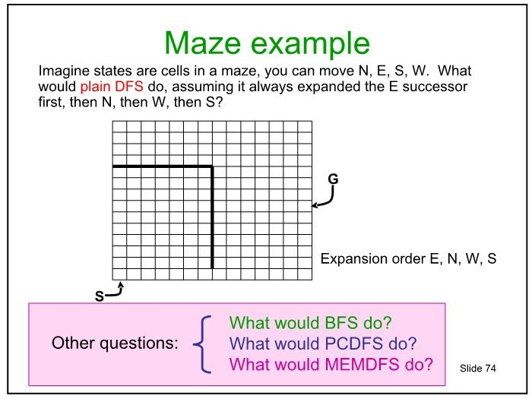
First, lets review a touch
N
W
E
S
start

Slide 3
N
W
E
S
start

Slide 4
N
W
E
S
start
What would BFS do?

Slide 5
N
W
E
S
start
What would BFS do?

Slide 6
N
W
E
S
start
What would BFS do?

Slide 7
N
W
E
S
start
What would BFS do?

Slide 8
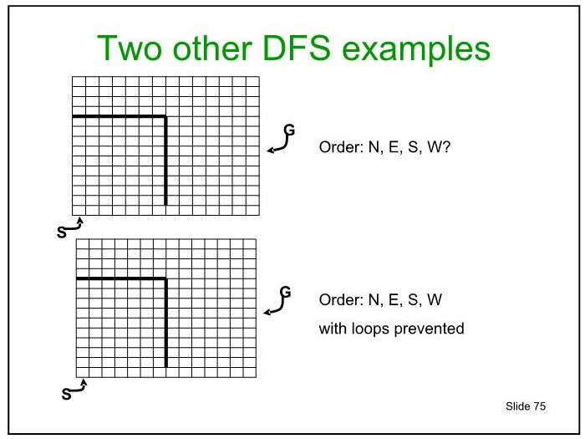

Slide 10
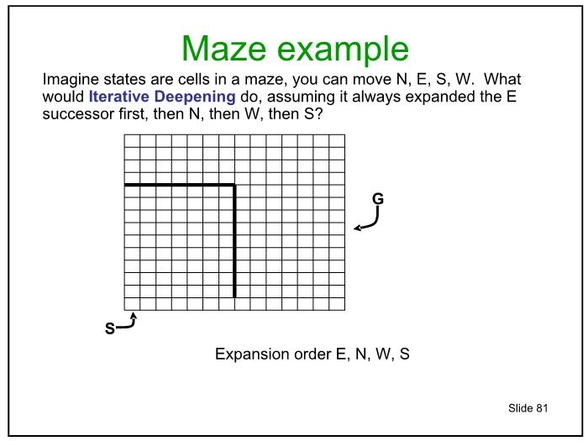

Slide 14
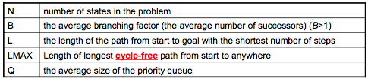
Back to judging the search algorithms
Algorithm | Complete | Optimal | Time Complexity | Space Complexity
BFS | Y | Y (if ...) | O(min(N,B^{L})) | O(min(N,B^{L}))
UCS | Y | Y | O(log(Q)*min(N,B^{L})) | O(min(N,B^{L}))
DFS** | Y | N | O(B^{LMAX}) | O(LMAX)
Iterative Deepening | Y | Y (if all transitions cost the same) | O(B^{L}) | O(L)
Question: why is iterative deepening optimal, but not DFS?

Slide 15
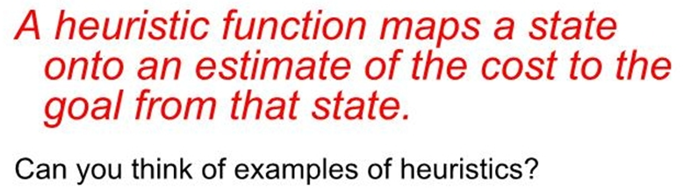
Heuristic functions
We can encode each notion of the “ merit” of a state into a heuristic function, h(s).
For planning a path through a maze?
For solving a Rubick’s cube?

Slide 16
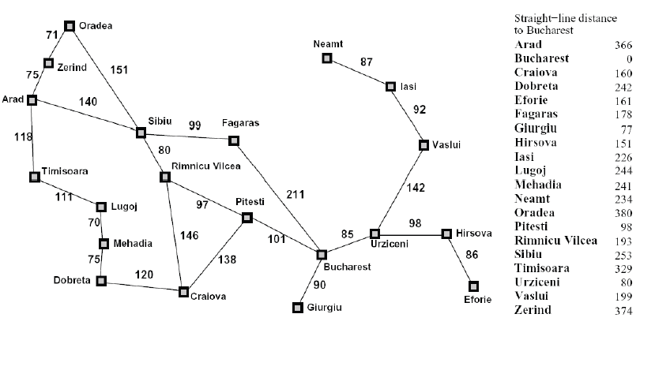
Euclidean distance as h(s)
Say we want to plan a path from Arad to Bucharest, and we know the straight line distance from each city to our goal. This lets us plan our trip by picking cities at each time point that minimize the distance to our goal (or maximize our heuristic).

Slide 17
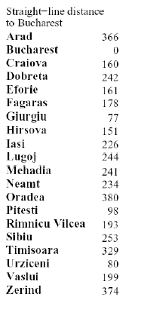
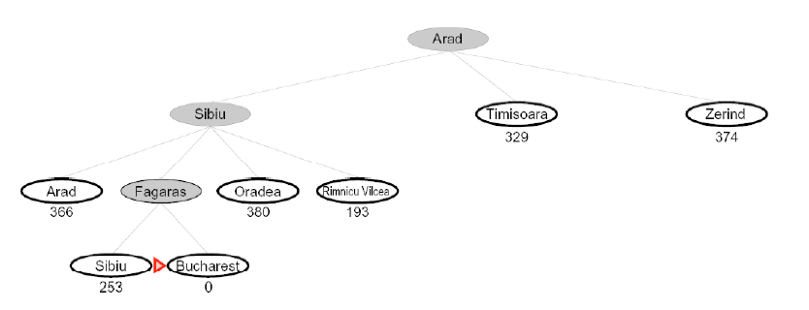
Greedy best first search
This search strategy is called greedy best first search.
How can it possibly go wrong??

Slide 18
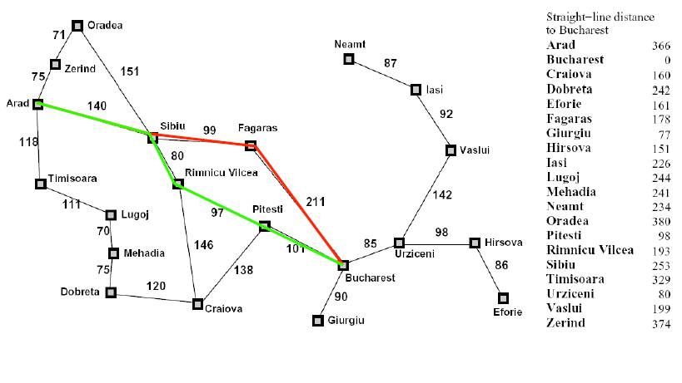
Greedy best first search
In red is the path we selected. In green is the shortest path between Arad and Bucharest. What happened?

Slide 19
Modifying the search
How to avoid the mistake?

Slide 20
Modifying the search
How to avoid the mistake?
Consider both the cost to get to a node AND the cost from it.

Slide 21
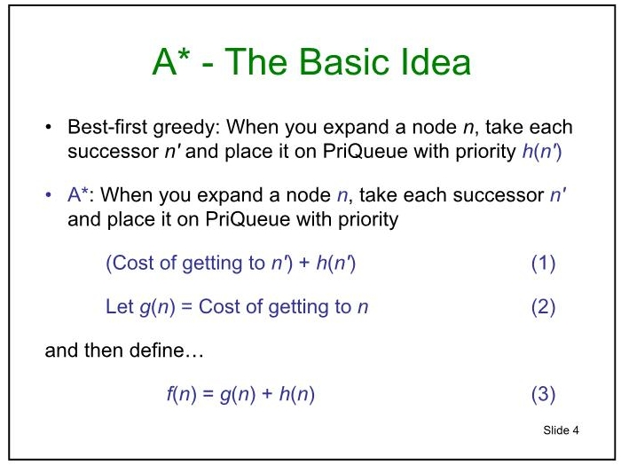

Slide 22
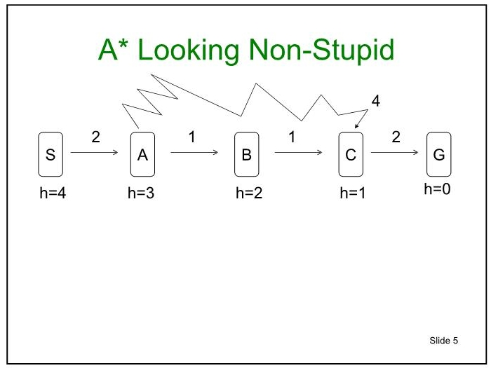
What will A* do here?

Slide 23
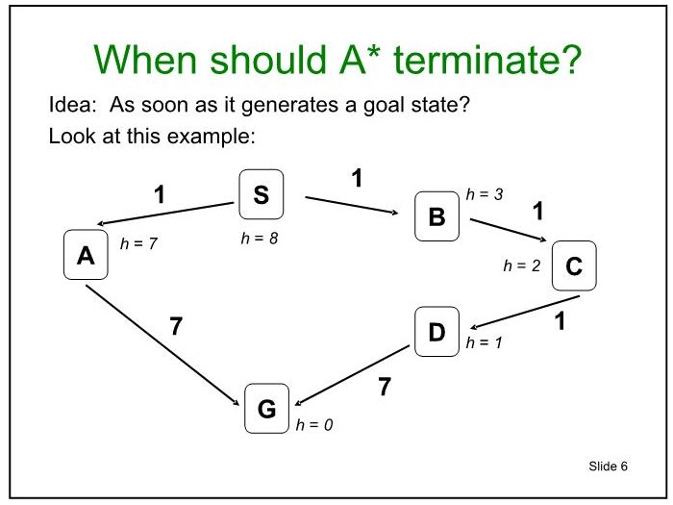
What will happen here??

Slide 24
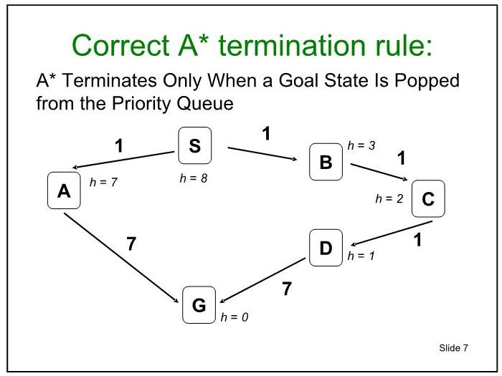

Slide 25
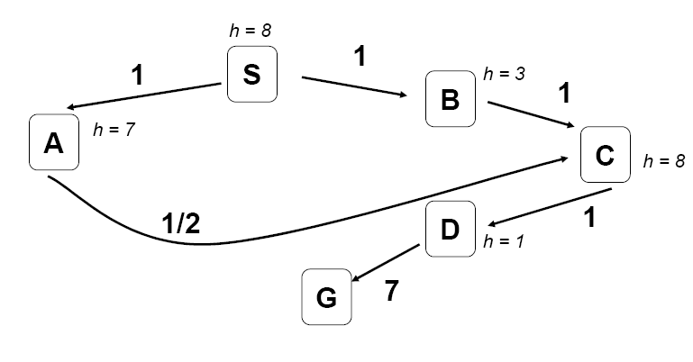
What happens when we visit nodes twice?

Slide 26
What happens when we visit nodes twice?
If A* discovers a lower cost path through a node as it is searching, it should update the priority of that node based on the lower path cost.

Slide 27
The A* Algorithm
Remember that g(n) is the cost of getting TO a node and h(n) is the estimated cost FROM it to the goal. f(n) is g(n) + h(n).
The Priority Queue (list of nodes to expand) starts off empty (we call this queue PQ).
The list of previously visited (state, f value, backpointer) triples starts of empty (we call this list V).
Put the Start state (S) into PQ and V with priority f(S) =g(S) + h(S) (= h(S). Why?)
Attempt to POP the element with the lowest f value from PQ.
-- Case 1: PQ is empty. Then there is no solution!
-- Case 2: We popped the Goal. Then we are done!
-- Case 3: We expand the node and generate its children! For each successor node (which we call n):
Define f(n) = g(n) + h(n).
If n is a NEW node we place it in PQ with priority f(n), OR
If n is ALREADY in PQ or if it was already expanded, and f(n) is a LOWER value than what we produced previously, place n in PQ with priority f(n) and update V accordingly.
Otherwise, IGNORE the node and move on.

Slide 28
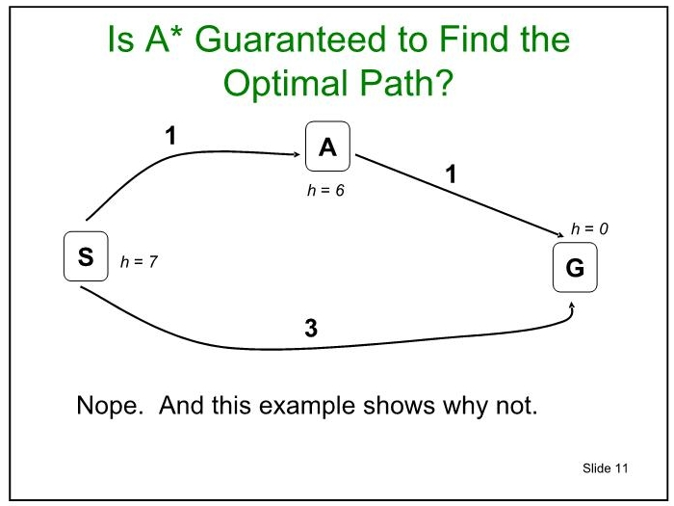

Slide 29
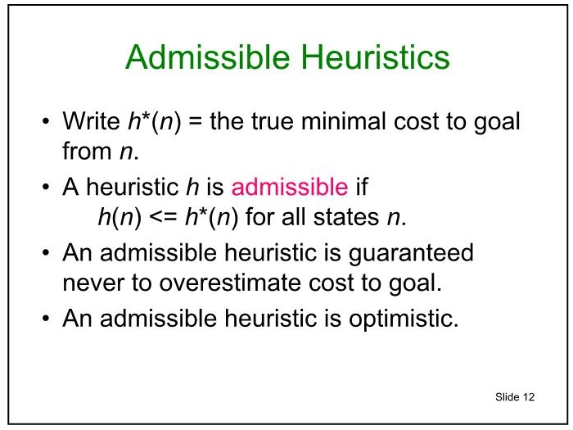

Slide 30

Admissible heuristics
Which heuristics are admissible for the 8 puzzle?
h(n) = number of misplaced tiles
h(n) = total Manhattan distance between tile locations in S and goal locations in G
h(n) = min (2, h*[n])
h(n) = h*(n)
h(n) = max (2, h*[n])
h(n) = 0

Slide 31
Admissibility implies optimality
The intuition is this: h(n) ≤ h*(n) means that the search won’t miss any promising paths.
  Why?
  Because if it really is cheap to get to a goal via node n (i.e., both g(n) and h*(n) are low), then f(n) = g(n) + h(n) will also be low, and the search won’t ignore n in favor of more expensive options.

Slide 32

Admissibility implies optimality
A* expands nodes in order of increasing f value
Gradually adds "f-contours" of nodes
Contour i has all nodes with f=f_{i}, where f_{i} < f_{i+1}

Slide 33
Monotonic (or consistent) heuristics
A monotone heuristic satisfies the condition
    h(n1) ≤ c(n1 → n2) + h(n2)
Note that there might more than one transition (action) between n1 and n2, and the inequality must hold for all of them.
If h(n) is admissible and monotonic, search will be both optimal and not “locally” mislead.

Slide 34
Some consequences of monotonicity
f-values of nodes along a path are non-decreasing.
  i.e. if n_{i} and n_{i+1}are nodes along a path, then f(n_{i}) ≤ f(n_{i+1})
  Proof: f(n_{i}) = g(n_{i}) + h(n_{i}) = cost(path to n_{i} )+ h(n_{i})
  ≤ g(n_{i}) + cost(n_{i}, n_{i+1}) + h(n_{i+1})
  But g(n_{i}) + cost(n_{i}, n_{i+1}) + h(n_{i+1}) = g(n_{i+1}) + h(n_{i+1})
  = f(n_{i+1})
  Which means …. f(n_{i}) ≤ f(n_{i+1})

Slide 35
Some consequences of monotonicity
If n2 is expanded after n1, then f(n1) ≤ f(n2).
  i.e. f-values of nodes that are expanded cannot decrease during the search.
  Why?
  Well, If n2 was on the frontier when n1 was expanded, then f(n1) ≤ f(n2). Otherwise we would have expanded n2 before n1.
  If, by contrast, n2 was added to the frontier as a result of n1’s expansion, then n2 and n1 lie along the same path and, as we demonstrated on the prior slide, f(n1) ≤ f(n2).

Slide 36
Some consequences of monotonicity
If node n has been expanded, every path with a lower f-value than n has already been expanded.
  Say we just expanded node n_{i} on a path to node n_{k}, and that f(n_{k}) < f(n).
  This means n_{i+1} is on the frontier and f(n_{i+1}) ≤ f(n_{k}), because they are both on the same path.
  BUT if n_{i+1} were on the frontier at the same time as node n, it would have been expanded before n because f(n_{i+1}) ≤ f(n_{k}) < f(n).
  Thus, n can’t have been expanded before every path with a lower f-value has been expanded.

Slide 37
Some consequences of monotonicity
The first time A* expands a node, it has found the minimum cost path to that node. Why?
  f(of the first discovered path to n) = cost(of the first discovered path to n) + h(n).
  Likewise,
  f(of any other path to n) = cost(of any other path to n) + h(n).
  From the prior slide we know:
  f(of the first discovered path to n) ≤ f(of any other path to n).
  This means, by substitution:
  cost(of 1st discovered path to n) ≤
  cost(of any other path to n)
  Hence, the first discovered path is the optimal one!

Slide 38
Is A* Complete? Will it terminate?

Slide 39
Assuming that there is a path to the goal and both costs and heuristic values are finite and positive, the f-contours will eventually grow to enclose it.
If, moreover, our heuristic is admissible, every time we revisit a node as we are searching, it means we found a path with a LOWER f-value attached to it than that which was previously discovered. In theory, that means we should not cycle! We should only ever find new paths to states with lower f-values.

Slide 40
Back to judging the search algorithms
Algorithm | Complete? | Optimal ? | Time Complexity | Space Complexity
BFS | Y | Y (if ...) | O(min(N,B^{L})) | O(min(N,B^{L}))
UCS | Y | Y | O(log(Q)*min(N,B^{L})) | O(min(N),B^{L})
DFS** | Y | N | O(B^{LMAX}) | O(LMAX)
Iterative Deepening | Y | Y (if all transitions cost the same) | O(B^{L}) | O(L)
A* | Y
If we set h(n) = 0 for all nodes, A* is UCS!

Slide 41
Back to judging the search algorithms
Algorithm | Complete? | Optimal ? | Time Complexity | Space Complexity
BFS | Y | Y (if ...) | O(min(N,B^{L})) | O(min(N,B^{L}))
UCS | Y | Y | O(log(Q)*min(N,B^{L})) | O(min(N),B^{L})
DFS** | Y | N | O(B^{LMAX}) | O(LMAX)
Iterative Deepening | Y | Y (if all transitions cost the same) | O(B^{L}) | O(L)
A* | Same as UCS | Same as UCS | Same as UCS | Same as UCS
If we set h(n) = 0 for all nodes, A* is UCS!

Slide 42
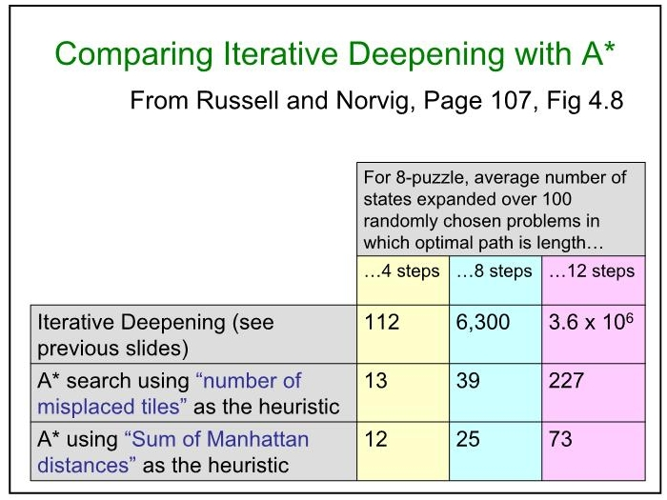

Slide 43
For problems with a lot of states, though, A* can STILL be a memory hog!
How can we limit its use of memory?

Slide 44
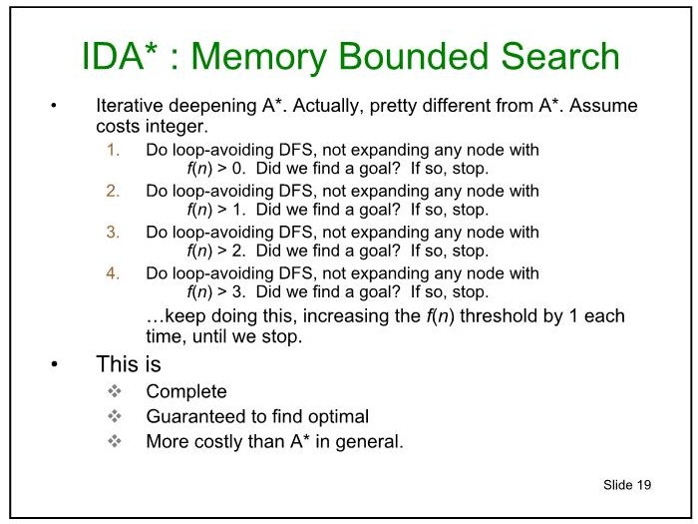
Iterative deepening A*. This is actually really different than A*.
To run it, lets assume that costs are all integers .
Guaranteed to find an optimal path.

Slide 45
8-Puzzle
f(N) = g(N) + h(N)
with h(N) = number of misplaced tiles
4
Cutoff=4
7

Slide 46
8-Puzzle
f(N) = g(N) + h(N)
with h(N) = number of misplaced tiles
4
Cutoff=4
4
7
7

Slide 47
8-Puzzle
f(N) = g(N) + h(N)
with h(N) = number of misplaced tiles
4
Cutoff=4
4
6
7
7

Slide 48
8-Puzzle
f(N) = g(N) + h(N)
with h(N) = number of misplaced tiles
6
4
Cutoff=4
4
6
7
7

Slide 49
8-Puzzle
f(N) = g(N) + h(N)
with h(N) = number of misplaced tiles
f(N) = g(N) + h(N)
with h(N) = number of misplaced tiles
7
6
4
Cutoff=4
4
6
7
7

Slide 50
8-Puzzle
f(N) = g(N) + h(N)
with h(N) = number of misplaced tiles
4
Cutoff=5
7

Slide 51
8-Puzzle
f(N) = g(N) + h(N)
with h(N) = number of misplaced tiles
4
Cutoff=5
4
7
7

Slide 52
8-Puzzle
f(N) = g(N) + h(N)
with h(N) = number of misplaced tiles
4
Cutoff=5
4
6
7
7

Slide 53
8-Puzzle
f(N) = g(N) + h(N)
with h(N) = number of misplaced tiles
6
4
Cutoff=5
4
6
7
7

Slide 54
8-Puzzle
f(N) = g(N) + h(N)
with h(N) = number of misplaced tiles
f(N) = g(N) + h(N)
with h(N) = number of misplaced tiles
7
6
4
Cutoff=5
4
6
7
7

Slide 55
8-Puzzle
f(N) = g(N) + h(N)
with h(N) = number of misplaced tiles
4
Cutoff=6
7

Slide 56
8-Puzzle
f(N) = g(N) + h(N)
with h(N) = number of misplaced tiles
4
Cutoff=6
4
7
7

Slide 57
8-Puzzle
f(N) = g(N) + h(N)
with h(N) = number of misplaced tiles
4
Cutoff=6
4
6
7
7

Slide 58
8-Puzzle
f(N) = g(N) + h(N)
with h(N) = number of misplaced tiles
4
Cutoff=6
4
6
8
7
7

Slide 59
8-Puzzle
f(N) = g(N) + h(N)
with h(N) = number of misplaced tiles
4
6
Cutoff=6
4
6
8
7
7

Slide 60
8-Puzzle
f(N) = g(N) + h(N)
with h(N) = number of misplaced tiles
4
6
6
Cutoff=6
4
6
8
7
7

Slide 61
8-Puzzle
f(N) = g(N) + h(N)
with h(N) = number of misplaced tiles
4
6
6
Cutoff=6
4
6
8
7
7

Slide 62
Building Heuristics by Relaxing Problems
A useful technique is to simplify a problem when building heuristics, and to let h(n) be the cost of reaching the goal in the easier problem.
For example, in the 8-Puzzle you can only move a tile from square A to B if A is adjacent (left, right, above, below) to B and B is blank
We can relax some of these conditions and:
  allow a move from A to B if A is adjacent to B (i.e. we can ignore whether or not position is blank),
  allow a move from A to B if B is blank (i.e. we can ignore adjacency),
  allow all moves from A to B (ignore both conditions).

Slide 63
Building Heuristics by Relaxing Problems
#3 leads to the misplaced tiles heuristic.
  To solve the puzzle, we need to move each tile into its final position.
  Number of moves = number of misplaced tiles.
  Clearly h(n) = number of misplaced tiles ≤ the h*(n) the cost of an optimal sequence of moves from n.
#1 leads to the manhattan distance heuristic.
  To solve the puzzle we need to slide each tile into its final position.
  We can move vertically or horizontally.
  Number of moves = sum over all of the tiles of the number of vertical and horizontal slides we need to move that tile into place.
  Again h(n) = sum of the manhattan distances ≤ h*(n)
    in a real solution we need to move each tile at least that that far and we can only move one tile at a time.

